Slide 1
JAVA Project EPITA DOCUMENTATION
Sandesh VAKALE MSc SE Fundamental

Slide 2
Information
Project Overview
Project Working
Connection to DB
Derby
BlueHost
Query
GitHub
Requirements
Eclipse
Required JARs
Additional
Future Implements
Console App
GUI App
Notes:
Beginning course details and/or books/materials needed for a class/project.

Slide 3
Project Overview
IAM : Identity Access and Management
Develop an application using java which can connect to any database which was chosen by user (For example: MySQL)The operation we need to perform in that database using java is creating, updating, deleting and listing the identities of the user.
Following operations that needs to be perform in that application
While(true)
{
Verifying a user login and password
Creating an identity
Updating an identity
Deleting an identity
Listing an identity
}
Notes:
Introductory notes.

Slide 4
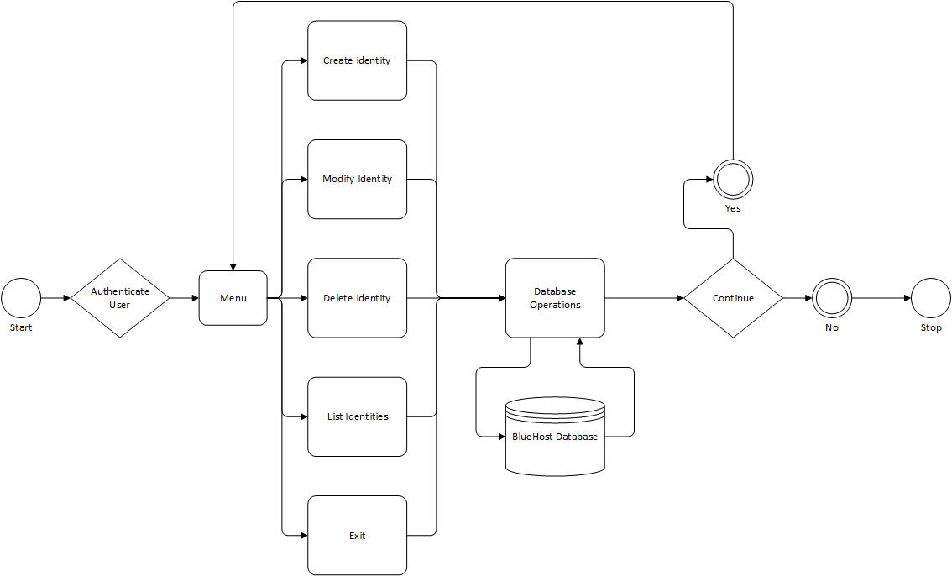
Project Working
Notes:
Objectives for instruction and expected results and/or skills developed from learning.

Slide 5
Connection to DB
To run this kind of project, we always need database to connect our project.
To create database, one can use different type of Frameworks.
Derby is one of them. To create connection to derby, we need to follow some steps that I already mentioned in my another ppt. Please find Derby connection ppt in this project repository.
In my project, I used BlueHost dataspace with MySQL Framework and myAdminPHP for table creation.
Notes:
Relative vocabulary list.

Slide 6
Query
To create and operate data from table, we need to run some queries.
You can embedded your derby or MySQL queries with java by Preparestatement .
One can take a look on JDBCClientisconnect file to see embedded queries and sql file t create table query.
Notes:
A list of procedures and steps, or a lecture slide with media.

Slide 7
GitHub
GitHub is cloud platform which allows one to save his /her project on online.
Uploading project on GitHub can be done in Three ways.
1. Git bash
2. Git for desktop
3. Git plugin to eclipse
Notes:
Example graph/chart.

Slide 8
Requirements
One can use either eclipse IDE or Visual Studio IDE to create project. In this project, I am using Eclipse IDE. Always Prefer latest version.
For Derby: Derbyclient.jar
For MySQL: mysql-connector-java-5.1.40-bin.jar
For Logger: commons-logging-1.2.jar
log4j-1.2.17.jar
log4j-api-2.6.1.jar
log4j-core-2.6.1.jar
Notes:
Example graph/chart.

Slide 9
Future Implements
Basically this project is console app. But by adding GUI, we can make it more better and user friendly.
Notes:
Conclusion to course, lecture, et al.

Slide 10
References
http://thomas-broussard.fr/work/java/courses/project/fundamental.xhtml
https://my.bluehost.com/hosting/help?_ga=1.109140610.683287682.1485182648
Notes:
An opportunity for questions and discussions.

